Slide 1


Slide 2
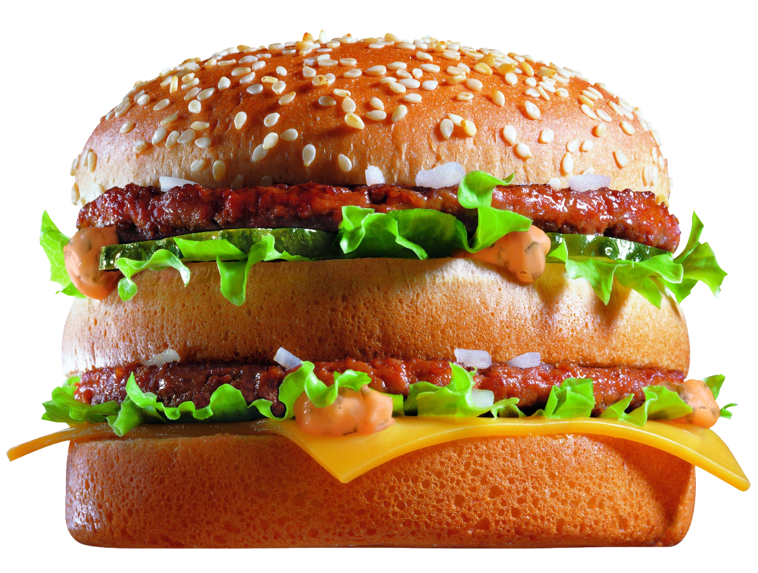


What do you see?

